Slide 1
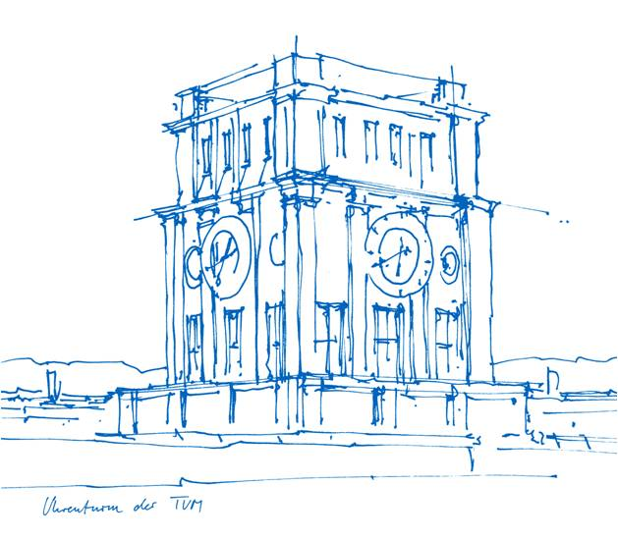
Vehicle-Infrastructure Cooperative 3D Object Detection to Support Autonomous Driving Functions
Interdisciplinary Project - Suren Sritharan
Notes:
Final presentation for my IDP on the topic of

Slide 2
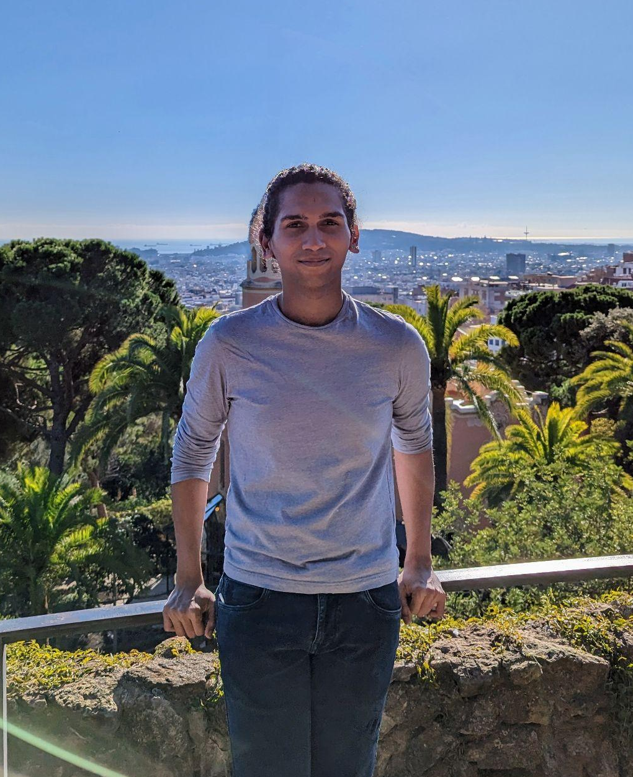
Suren Sritharan
Informatik - M.Sc
Focus area - Computer vision, Machine learning
Providentia++ - Monocular 3d object detection
Notes:
Before going into the topic, a bit about me.
I’m doing my informatik Msc at TUM and currently in my third semester.
My focus areas are machine learning and computer vision, and my prior experience in these fields have been quite diverse including areas such image enhancement, medical imaging, object detection and tracking. Most recently I was working in the providentia++ project on monocular vision, and this IDP is an extension of this project.

Slide 3
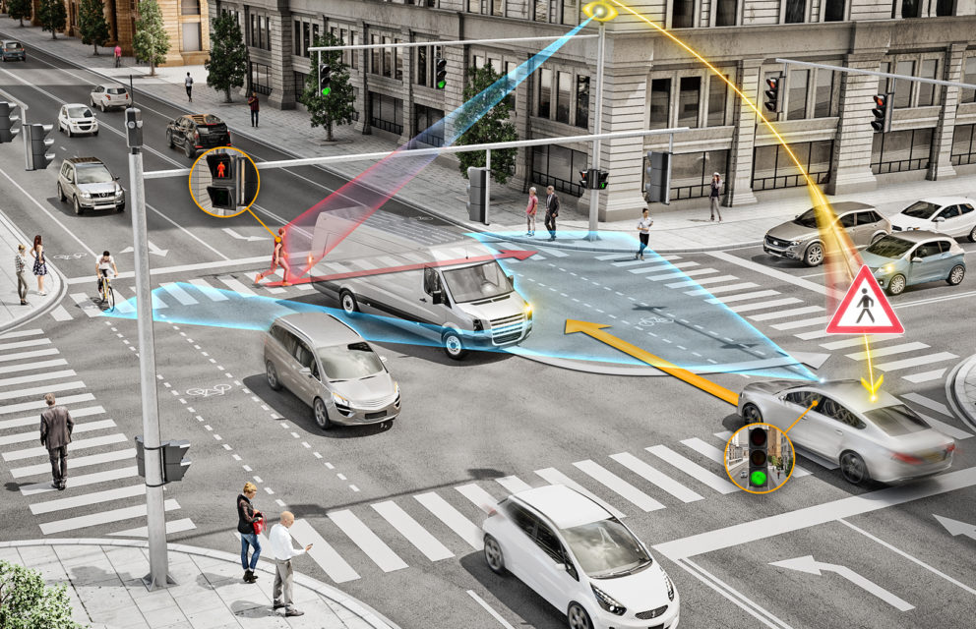
Motivation - 3D object detection
3D object detection is vital for autonomous driving tasks.
Traditionally vehicular or infrastructure sensors were used as sole inputs for object detection.
Single point-of-view sensors have limitations : occlusion, limited field-of-view, and low-point density.
Notes:
Motivation…
Object detection in the context of autonomous driving is vital.
Identifying vehicles and vulnerable road users helps us in a wide range of applications.
Traditionally 3D object detection was done by individual sensors, mounted on vehicles or road side camera and lidars.
This means that the algorithm can view the environment from a single POV. This has certain limitations like occlusion

Slide 4
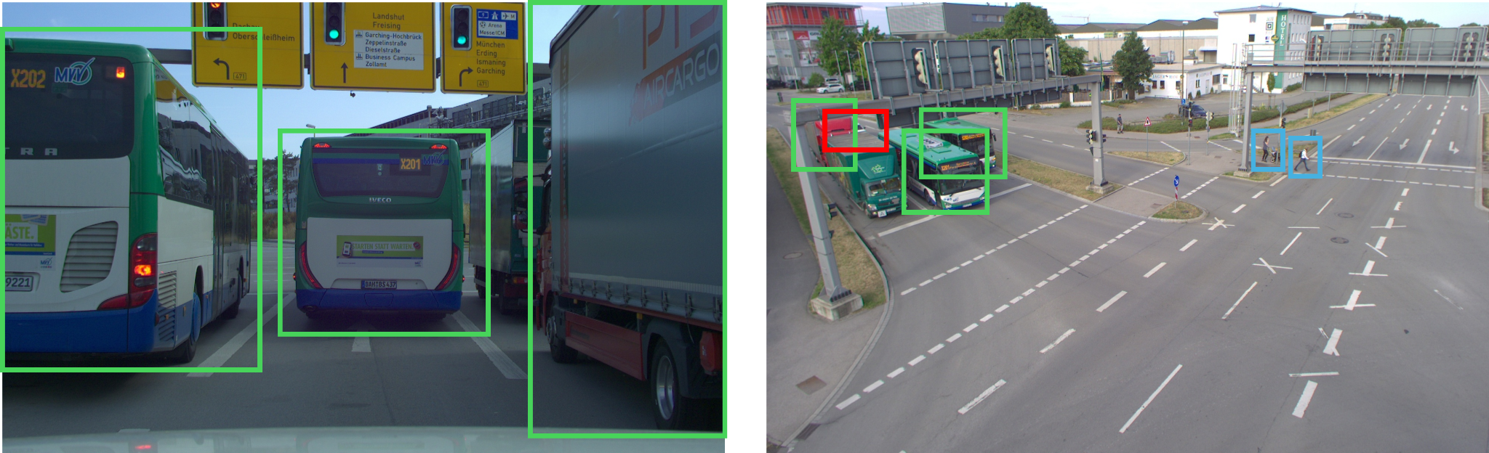
Motivation - Cooperative perception
vehicular perspective
infrastructure perspective
Notes:
For instance consider these images which show the vehicular and infrastructure perspective of a particular instance.
The 3 large vehicles marked in green occlude the ego-vehicles view.
The ego-vehicle marked in red in the left image, therefore can’t see any of the objects like the pedestrians marked.
The solution for this would be to use multiple sensors, which work together to perform object detection.

Slide 5
Vehicle-Infrastructure Cooperative 3D Object Detection
Combine data from infrastructure sensors and vehicular sensors for cooperative 3D perception
Notes:
Thus, the objective of this IDP is to combine data obtained from VI sensors in a cooperative manner for 3D perception.
This helps overcome issues of single POV algorithms that we saw before.

Slide 6
Cooperative perception challenges
Latency and data loss
Data processing + communication should be done in real-time.
Solutions such as edge pre-processing, low-latency communication protocols are present.
Communication and synchronization
Standardized sensor communication for efficiency as efficacy.
Sensor synchronization between different objects.
Model design
Choice of sensors and models.
Study both efficiency and efficacy of models.
Notes:
Though intuitively this should improve the performance, moving from single sensors to multi-sensor pose many challenges like latency, communication, model design, Security and reliability.
In term of latency, one must ensure that all the processes (including communication and dataprocessing) takes place in real time.
Furthermore, when using multiple sensors, one should also ensure that the sensors are synchronized
Though many such problems exists, the main focus of this IDP is kept on model design, where the architecture and the sensors must be chosen considering the efficiency and efficacy.

Slide 7
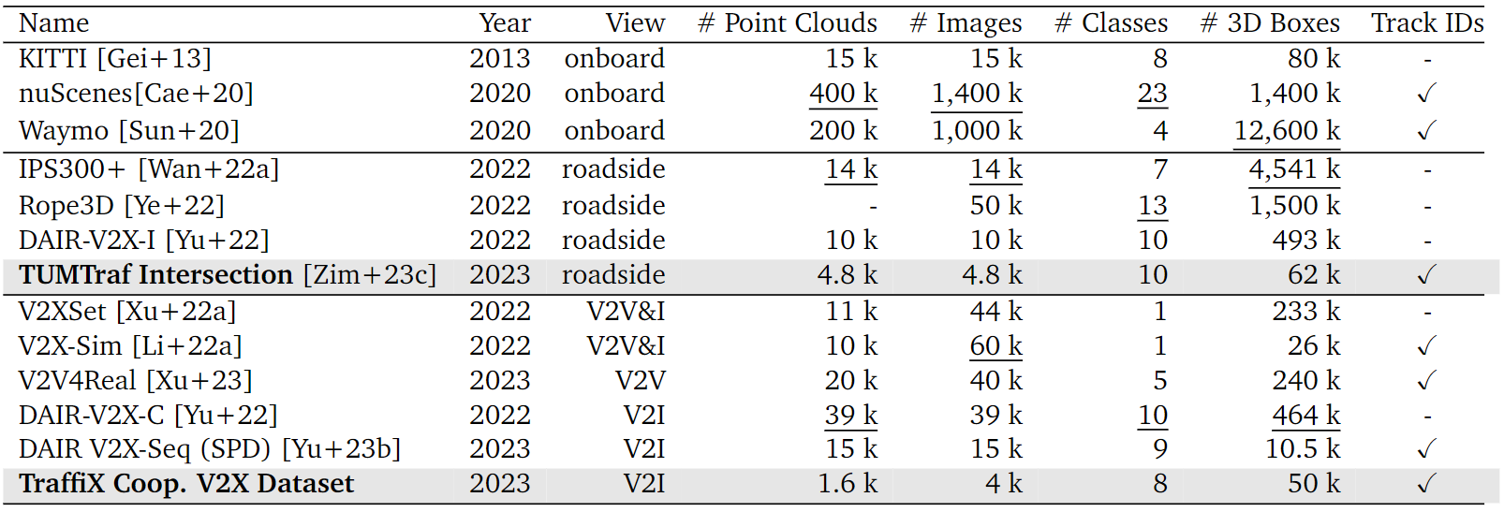
Datasets - vehicle, infrastructure and V2X
Notes:
First a brief introduction to the datasets in the domain of autonomous driving
These datasets can be divided based on the perspective as vehicular infrastructure of V2X dataset.
Vehicular datasets are quite common, like …., and these are larger in size with more annotation.
Infrastructure datasets are less common due to the complexities of building RSUs.. These are also smaller in size...
Cooperative datasets use data from multiple perspectives. These are rare since the infrastructure and vehicle sensors should be in communicable distance and must perceive th same environment.

Slide 8
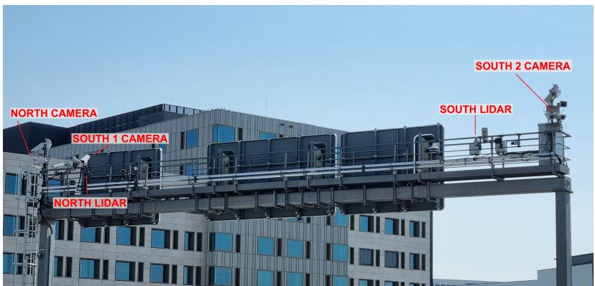
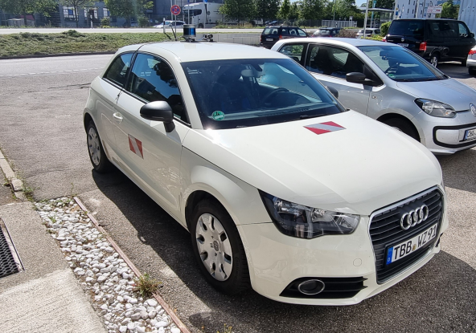
TUMTraf dataset
TUMTraf cooperative dataset
Vehicle : 1 LiDAR + 1 camera
Infrastructure : 1 LiDAR + 3 camera
~ 50 k labeled objects
TUMTraf intersection dataset
Infrastructure : 2 LiDAR + 2 cameras
~ 62 k labeled objects
Notes:
(3.5) This project uses two datasets from the TUMTraf dataset family.
The first is the cooperative dataset, taken from one set cam lidar pair on the vehicle and
The Basler ace acA1920-50gc cameras with a resolution of 1920x120.
The intersection contains three cameras, namely south 1, south 2, and north, with an 8mm lens, and a single camera is mounted
on the vehicle with a 16 mm lens. One Ouster OS1-64 LiDARs was used on the infrastructure
side, with a range of 120 m and a field of view of 360o × 45o. A Robosense RS-LiDAR-32 is
mounted on the vehicle, with a range of 150 m and a field of view of 360o × 70o.

Slide 9
Prior works - 3D object detection
Sensor-based classification
Camera-only : FCOS3D (2021), LSS (2020)
LiDAR-only : PointPillars (2019), PillarGrid (2022)
C+L fusion model : PointPainting (2019), BEVFusion (2022), CMT (2023)
Viewpoint-based classification
Vehicular viewpoint model : BEVFusion (2022), CMT (2023)
Infrastructure viewpoint models : InfraDet3D (2023)
V+I cooperative models : BEVFusionCoop (2024)
Notes:
(4.5) Next looking at the Prior works in 3d Object detection, these can be divided based on the sensors used and the viewpoints.
Cameras and Lidars are the most common types of sensors used for data collection. In this way, the models can use either cameras or point cloud data data or both together for object detection.
Initial works were based on camera, due to the cost, but LiDAR became popular later and outperformed cameras, specially due to their robustness.
However, most recently fusion model which fuse both camera and LiDAR data have become popular since the sensors complement each other.

Slide 10
Prior works - 3D object detection
Sensor-based classification
Camera-only : FCOS3D (2021),
LiDAR-only : PointPillars (2019), PillarGrid (2022)
C+L fusion model : PointPainting (2019), BEVFusion (2022), CMT (2023)
Viewpoint-based classification
Vehicular viewpoint model : BEVFusion (2022), CMT (2023)
Infrastructure viewpoint models : InfraDet3D (2023)
V+I cooperative models : BEVFusionCoop (2024)
Notes:
(5.5) In terms of viewpoint based classification, vehicular models were the most common since sensors mounted on vehicles are essential for decision making. These can be camera only lidar only or fusion model…
Infrastructure only models aren’t as common due to the complexities
Lately cooperative models which use data from multiple viewpoints have outperformed single viewpoint models even when using a single type of sensor (like pillargrid)
So in this work CMT, which is a vehicle only fusion model was used as a foundation to build a cooperative model for 3d object detection.

Slide 11
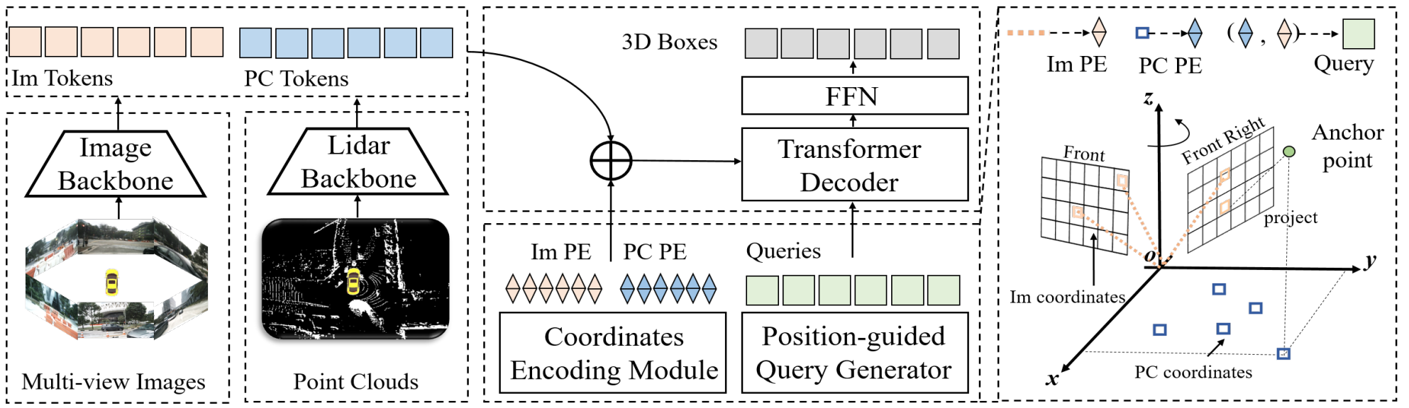
Cross Modal Transformers
Image / point cloud backbone
CEM
Query generator
Notes:
(6.5) Next to give you a brief idea about the model of CMT… It has three main components
The first is an image and point cloud feature extraction backbones which creates tokens for the images and point clouds.
Then for each token position encoding is created using CEM… and these two are combined to create position encoded feature tokens.
Next the query generator creates creates queries in a two step process, first by creating anchor points in the 3D space, and then creating a PE for each point in image and lidar space.
Then these queries interact with the PETs in the decoder, and are updated in multiple layers of the decoder… to create a deep feature embedding.
Finally these deep features are passed onto a feed forward network to predict the 3d boxes

Slide 12
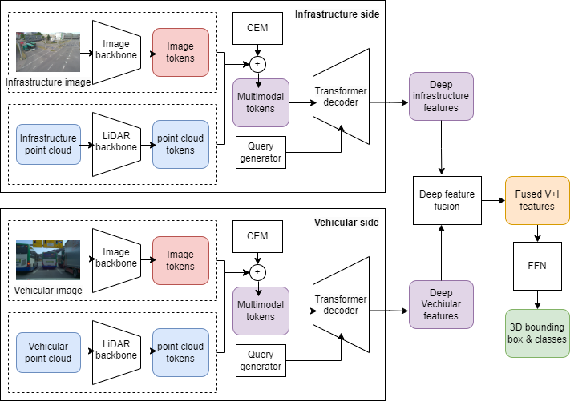
Model architecture - CMT for Cooperative perception
Notes:
(7.5) So inspired by this architecture, a cooperative perception model was created, where the deep feature encoding module was implemented both on the infrastructure and vehicle sides…
Then these deep features were fused together and passed onto a FFN to predict the boxes
NXT
The model was finally trained in an end to end manner with a weighted combination of focal loss for classes and L2 loss for bbox regression

Slide 13
Cross Modal Transformers
Deep feature encoding module
Notes:
The deep feature encoding model in each side is similar to the original CMT implementation with minor modifications

Slide 14
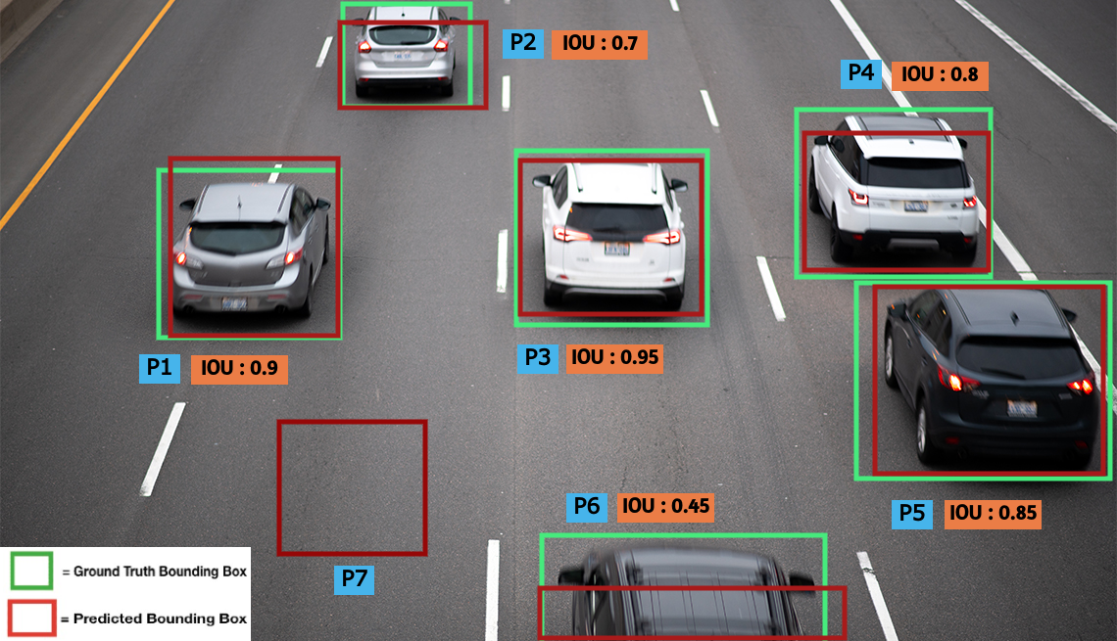
Evaluation metrics
mean average precision (mAP)
Measure of efficacy
mAP_{BEV} and mAP_{3D}
frames per second (FPS)
Measure of efficiency ( > 10 FPS)
GPU memory usage
Measure of model complexity
Notes:
(8.5) As mentioned at the beginning, the model was evaluated on two majoe measures : efficacy and efficiency
The efficacy is measured through 2 types of mAP scores… one the maP from BEV, and the other considering the 3D IOU
The efficiency is measured through FPS,
finally the model complexity is measured in terms of the GPU usage since the model must be deployable on and end device.

Slide 15
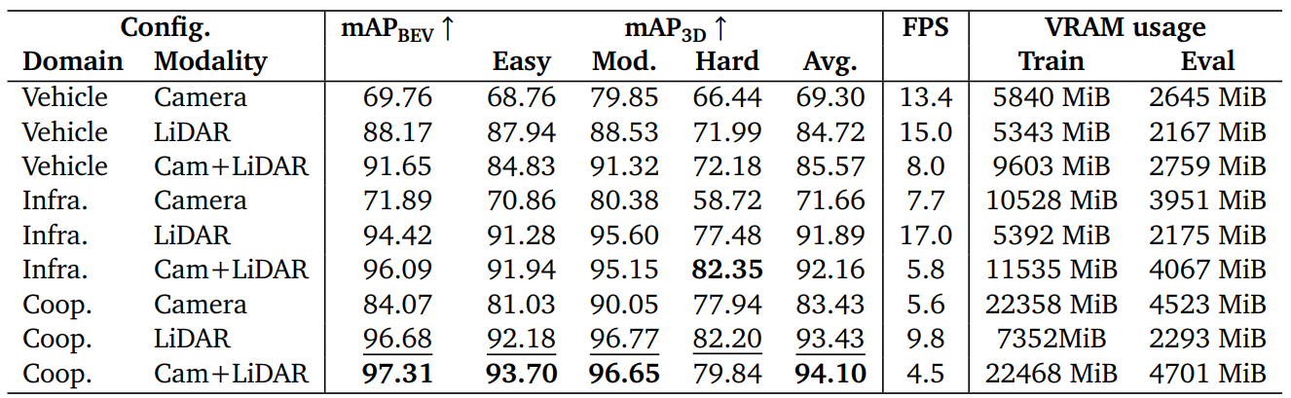
CMTCoop performance - multiple configuration
Notes:
(9) The first objective of this study is to show that cooperative perception works better than single viewpoint, and sensor fusion works better opposed to relying on single sensors.
This table shows the performance variation for every configuration. The 3D mAP has three separate measures depending on the toughness of detection but we’ll look at the average 3d map
And in addition the VRAM usage was measured during training and evaluation, but only the evaluation memory usage is important to us
We see a general trend of infra > vehicle > cooperative ,+8.5 3d map
Also, Lidar > camera > fusion
Looking at FPS, we see that most of the models < 10 FPS less than ideal for near real time
Evaluation VRAM usage ~ 4GB, manageable for an edge device.

Slide 16
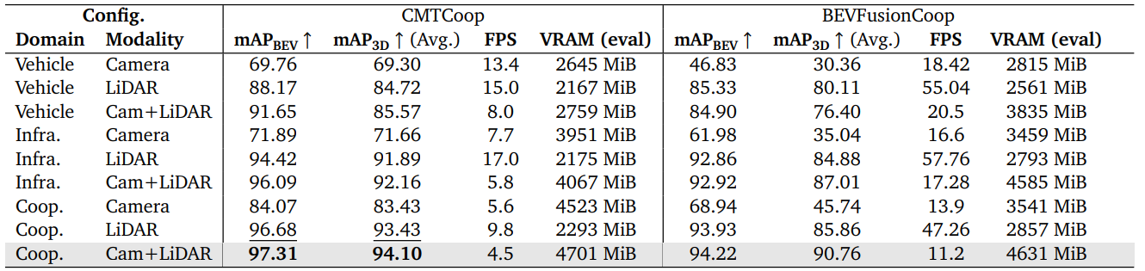
CMTCoop vs BEVFusionCoop
Notes:
(10) Compare with SOTA model on tumtraf coop dataset.
In general, CMTCOOP > BEVFusionCOOP for most config.
However, the speedup of the model is much higher in the BEVCOOP.
Nevertheless, with a target of around 10 FPS, we can still find a CMTCoop configuration CMTCoop-L performs better than BEVFusionCoop

Slide 17
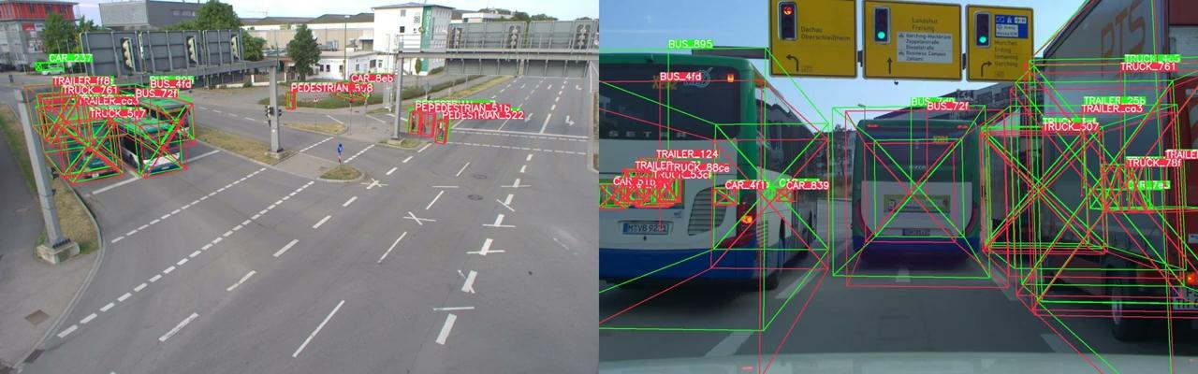
Comparison : Predictions of vehicle-only model
vehicular perspective
infrastructure perspective
Notes:
(11) Next we look at some qualitative results.
Here we see the predictions of the vehicular only model (CMT model)
Occluded by bus… the vehicular only

Slide 18
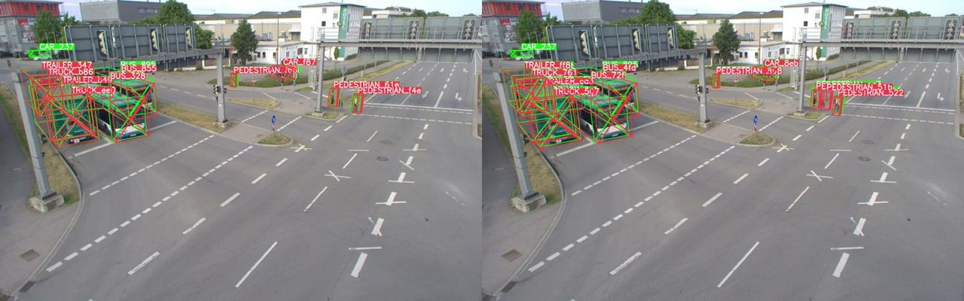
Vehicle-only vs cooperative model
CMTCoop cooperative model
CMT Vehicle-only model
Notes:
(12) Next we look at the predictions from the CMTCoop model *left) and the CMT vehicle model from the infrastructure perspective
So ultimately we see how cooperative perception helps overcome challenges of Vehicle only model

Slide 19
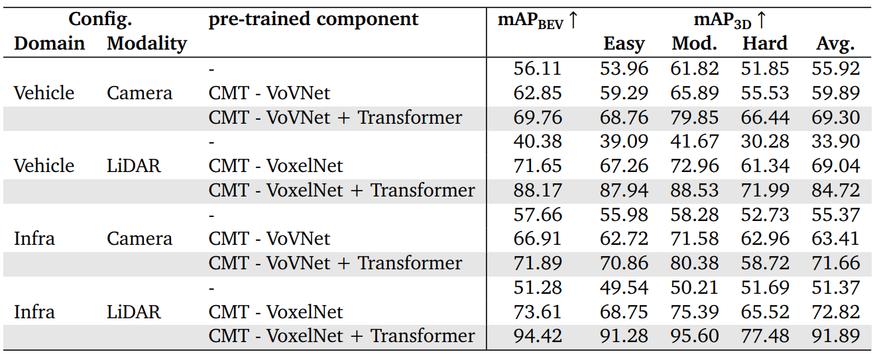
Ablation study - Effect of transfer learning
Pretraining models on TUMTraf intersection dataset
Notes:
(13) Next, one of the ablation studies conducted was the effect of transfer learning,
Sincer transformer based models often require a large amount of data, pretraining is require to achieve a good level of performance.
For this we first pretrain the vehicle only or Lidar only model on the TUMTraf intersection dataset, and observe the effect of transferring different components

Slide 20
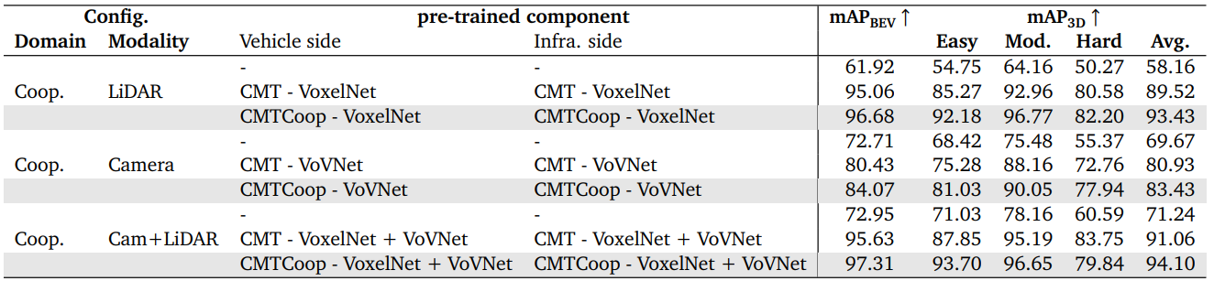
Ablation study - Effect of transfer learning
Pretraining on TUMTraf intersection dataset vs TUMTraf coop dataset
Notes:
Again, for the cooperative models we observe that pre training helps.
However, we make another observation here.
1sr line - No pretrainig
The second line is a coop model pretrained purely on TUMTraf infra dataset
The third line is a coop model pretrained onTUMTraf coop dataset.
When pretrained on Coop dataset, the performance is higher than when trained on the infra dataset… and this might hint another issue which is overfitting

Slide 21
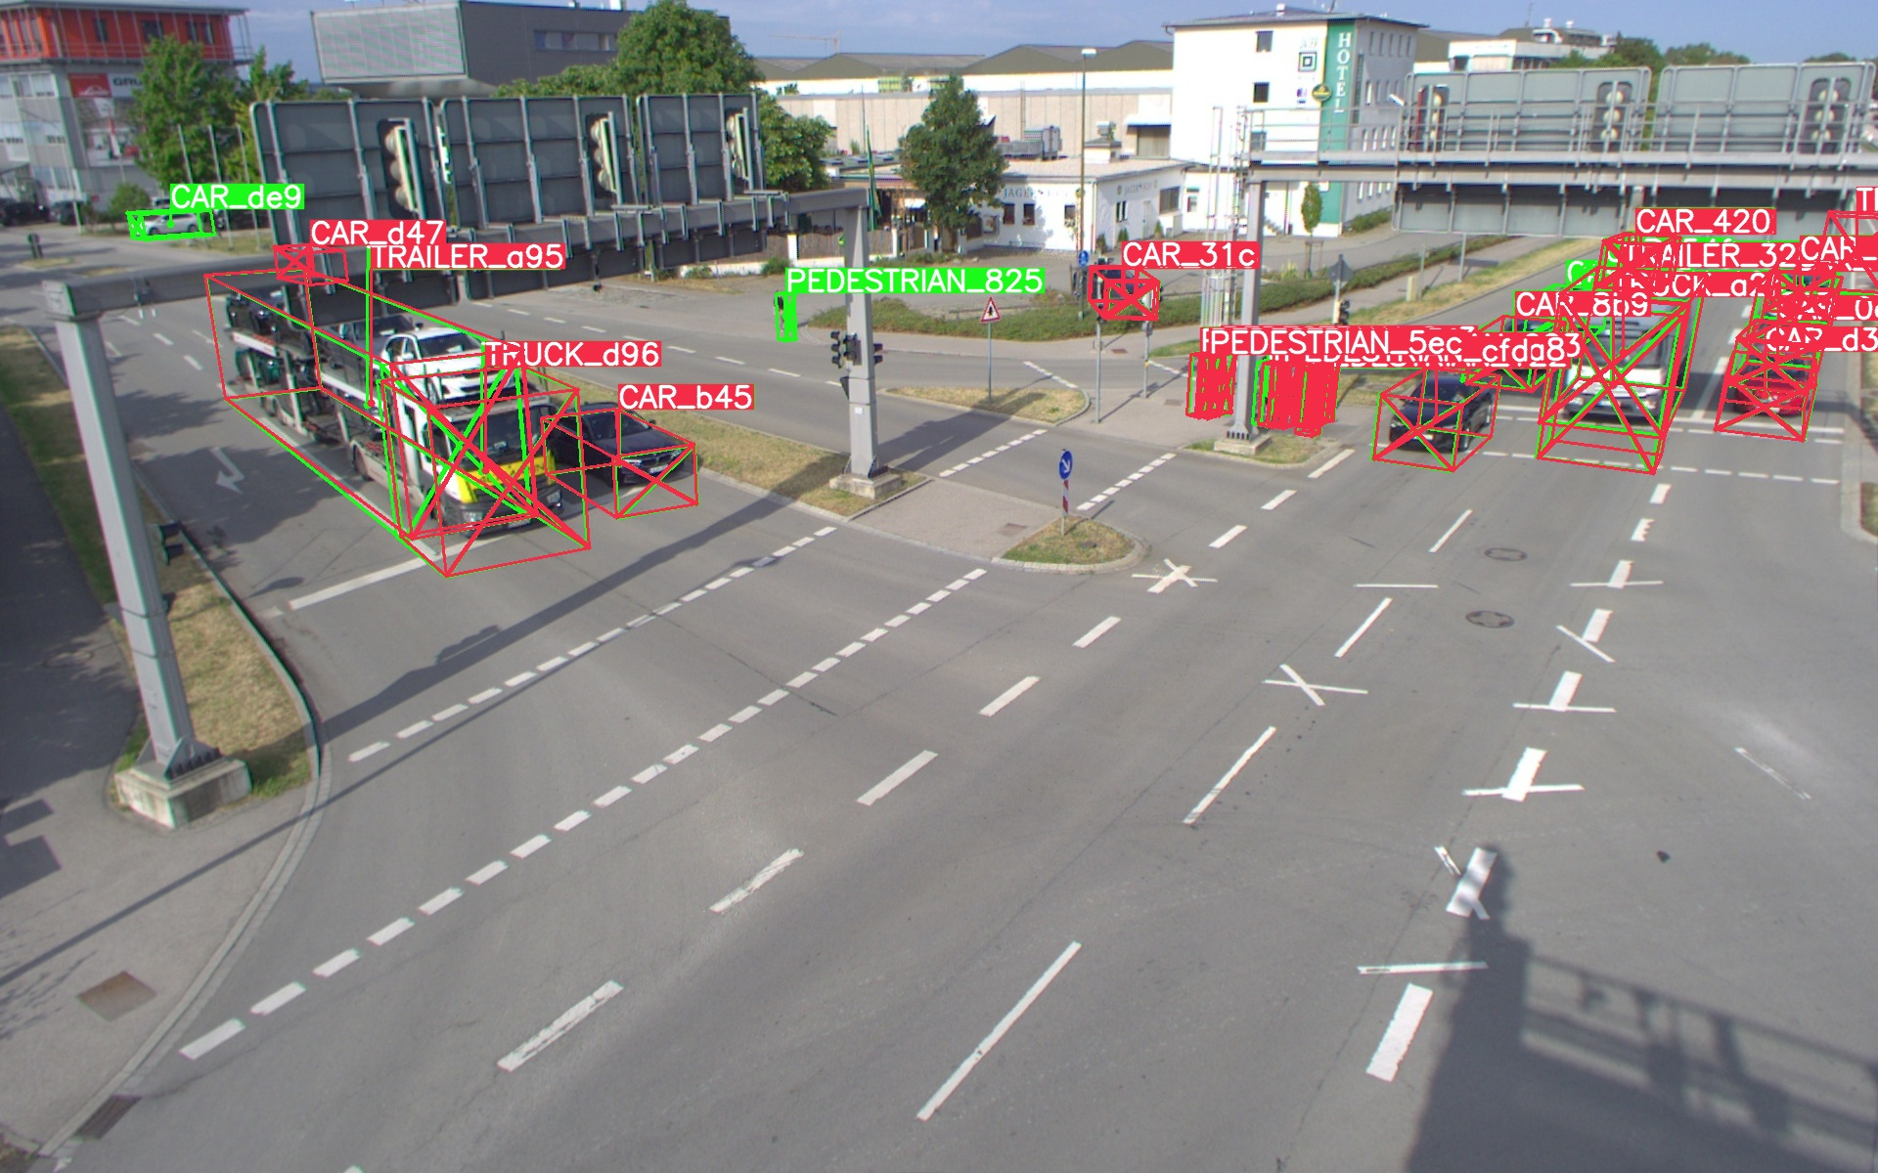
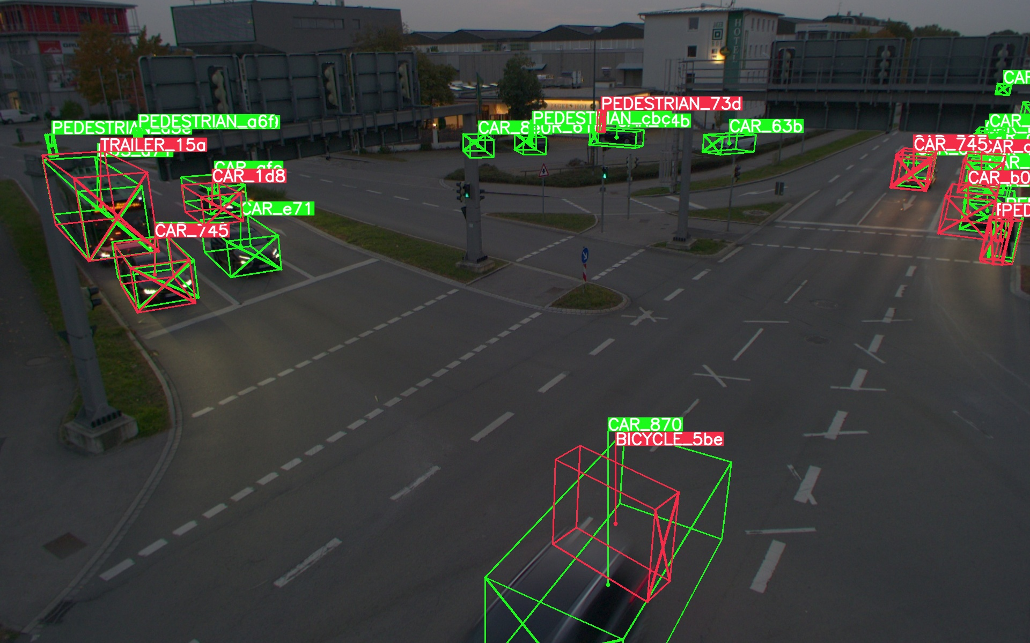
Shortcomings - Overfitting
Model trained on 500 set data and evaluated on two different sets
500 set (day)
800 set (night)
Notes:
(14) Well discuss this next.
For this we’ll use 2 versions of the TUM Traf coop dataset. The first one with 500 drames (day), and the second one with 800 frames (day _ night).
When the model is trained only on the first set, and then evaluated on the second, we see that the predictions are quite poor

Slide 22
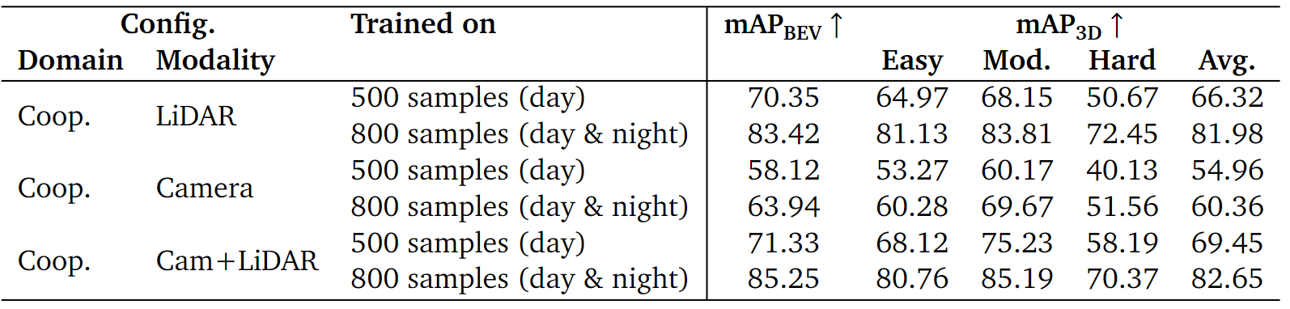
Shortcomings - Overfitting
Model trained on 500 set vs 800 set
Model evaluated on 800 set
Notes:
This was further extended, where in this case we first train the model on 500 set and then test it on the 800 set.
Then we retrain the model on the new 800 data set and test it on the same one.
So in each of these three cases, we observe that the model trained on 500 set data performs worse on the larget set.
When additional data was included the performance improves, but this is still less than the best performing model we discussed.

Slide 23
Future works
Improve efficiency
Backbones, voxelization
Integrate into live system
Latency, data loss, synchronization
Overcome overfitting
Extending the dataset
Modifying components
Deep fusion - Multidimensional convolution / cross attention
Post processing - 3D NMS
Notes:
(15) Based on these shortcomings, future works are presented.
The first is to improve the efficiency by modifying the backbones and the voxelization process.
For instance CMTCoop uses VoxelNet, and VoVNet backones and spconv voxelation which is slower
BEVFusCoop uses pointpillar and yolo v8s and torchsparse voxelization. and using these component could lead to better FPS
Then the next problem is integrating other considerations such as synchronization and latency so that this can be deployed in a real life system.
The next shortcoming is the lack of data which results in overfitting. This also makes it harder to train using complicated components…
so as the final part the dataset should be extended and diversified

Slide 24
Conclusion
CMTCoop for cooperative perception leads to 9.9% increase in mAP over CMT
+3.4 mAP improvement over SOTA on TUMTraf cooperative dataset.
~10 FPS which could further be improved by modifications.
Extending dataset to overcome overfitting and propose complicated components.

Slide 25
Thank you

Slide 26
Appendix

Slide 27
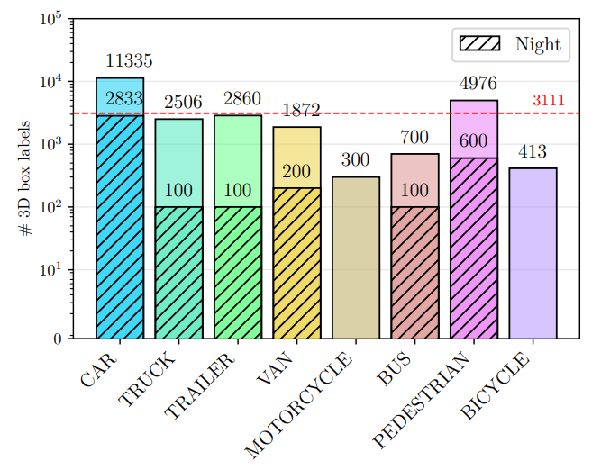
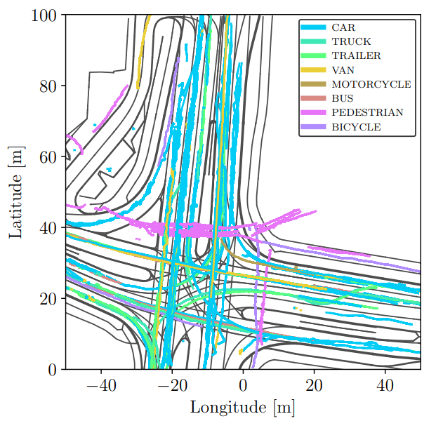
Shortcomings - Biases in dataset
Class distribution of dataset
BEV visualization of tracks

Slide 28
Data preparation - move to appendix

Slide 29
Post processing - Move to appendix

Slide 30
Data Augmentation
LoadPointsFromFileCoop
LoadPointsFromMultiSweepsCoop
LoadMultiViewImageFromFilesCoop
LoadAnnotations3D
VehiclePointsToInfraCoords
TransformLidar2ImgToInfraCoords
UnifiedObjectSampleCoop*
GlobalRotScaleTransAllCoop*
ResizeCropFlipImageCoop*
PointsRangeFilterCoop
ObjectRangeFilter
ObjectNameFilter
PointShuffleCoop*
NormalizeMultiviewImageCoop
PadMultiViewImageCoop
DefaultFormatBundle3DCoop
Collect3DCoop

Slide 31
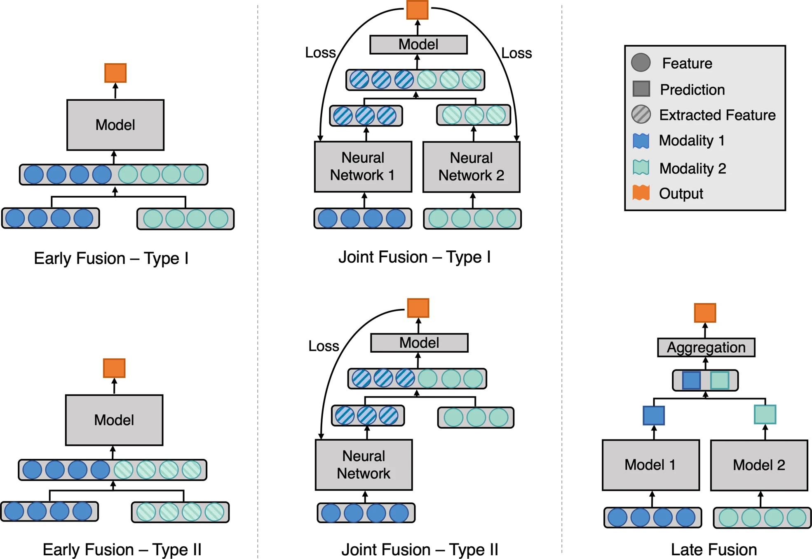
Approach - Cooperative perception
Improving model efficacy through sensor fusion.
Categorization
Early Fusion
Late Fusion
Deep Fusion
Notes:
The approach for this is known as sensor fusion where data obtained from different sensors are fused together in order to make a single final prediction.
The approach can be divided into 3 as early, late and intermediate fusion.
In early fusion raw data from different inputs are aggregated together before being passed to a decision making model.

Slide 32
Approach - Cooperative perception
Improving model efficacy through sensor fusion.
Categorization
Early Fusion
Late Fusion
Deep Fusion
Notes:
On the other hand in late fusion data from different sensors are passed through a decision making model, and then the individual output is fused together using some aggregating function to obtain a single output.

Slide 33
Approach - Cooperative perception
Improving model efficacy through sensor fusion.
Categorization
Early Fusion
Late Fusion
Deep Fusion
Notes:
Finally, in deep fusion features are aggregated at deep feature level, instead at the beginning or the end.
The main difference compared to other techniques is that the feature extractor is trained together with the model.
All these approaches have their advantages and disadvantages, however recent works have shown that deepfusion has performed well in comparison to other techniques in terms of both efficacy and robustness.

Slide 34
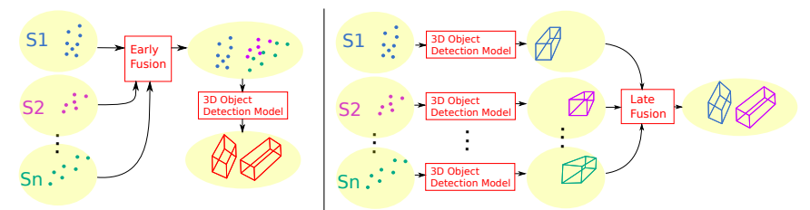
Approach - Cooperative perception
Fusion of data can be done before object detection (early fusion) or after (late fusion)
Illustration of early fusion (left) and late fusion (right) approach
Notes:
In the context of 3d object detection, if we consider the following example with multiple lidar sensors… named S1….
in early fusion as seen on the left, the data is fused together to form a single point cloud representation which is then passed through an object detection model.
On the other hand, in late fusion, each point cloud is passed through the object detection model and then fused to obtain an output.

Slide 35
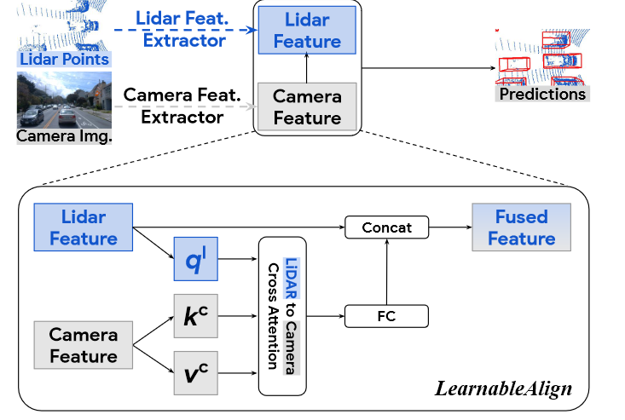
Cooperative perception - DeepFusion
Deep feature level fusion with lidar features and learned camera features.
Effective alignment mechanism for multi-modal deep fusion.
End-to-end model training.
Notes:
One such work is DeepFusion which is the SOTA in multimodal fusion from last year, and this will be used as the baseline.
The authors propose an end to end trained model for 3d object detection from camera and lidar data obtained from a moving vehicle. The main contribution of this work is their proposed network which performs multimodal fusion at deep feature level. The challenge of this approach is the alignment at deep feature level, and through ablation studies, the authors show that the proposed deep feature alignment stage (Learn Alilgn) improves the accuracy significantly compared to prior works.
DeepFusion suggests the use of 2 mtds steps namely InverseAug and Learnable align for point augmentation and deep feature alignment.
Multimodal fusion is quite challenging, in the sense when both images and points clouds are present, Traditional approaches either project lidar points to 2d images, and use an image processing model or decorate lidar points with learned image features. Fundamentally these are both early fusion approaches since they use pretrained models for feature extraction which are then used for projection or fusion between modalities. The extracted features are heuristic. Deep fusion on the other hand fuses the features at deep feature level, which avoids the domain gap.
Li, Y., Yu, A. W., Meng, T., Caine, B., Ngiam, J., Peng, D., ... & Tan, M. (2022). Deepfusion: Lidar-camera deep fusion for multi-modal 3d object detection. In Proceedings of the IEEE/CVF Conference on Computer Vision and Pattern Recognition (pp. 17182-17191).

Slide 36
Cooperative perception - other approaches
Vehicular-Infrastructure lidar fusion
VINet, VI-eye, PillarGrid
Vehicular camera-lidar fusion
DeepFusion, BEVFusion, PointPainting
Vehicular-Infrastructure camera fusion
Infrastructure camera-lidar fusion
Vehicular-Infrastructure camera-lidar fusion
Notes:
Now that we’ve looked at the models… next question is the choice of sensors
There are many ways to approach this problem.
The first is the most common.. points clouds VI lidar fusion
Next, works such as DeepFusion uses images and point clouds obtained from vehicles for object detection.
The next couple of approaches are not so common due to the lack of data. In general images obtained from infrastructure cameras are uncommon, so the works are also limited. However, recently datasets such as DAIR-V2X and A9 V2I dataset which is being collected now will enable working on both camera and lidar from VI, and thus this will be the focus of the IDP.
The reasoning behind this is that these sensors are complementary and provides diverse data - cam (high res texture, and shape) lidar (low res depth)

Slide 37
Cooperative perception - datasets
Infrastructure datasets
A9 dataset
Vehicular datasets
KITTI - camera (+laser)
nuScenes - camera + lidar (+ radar)
Waymo open - camera + lidar
Infrastructure + Vehicular
DAIR-V2X
A9-V2I dataset
CARTI
Notes:
CARTI - PillarGrid, VI-eye
infra - (on the A9 Autonomous Driving Test Stretch)
vehicular - (camera and LiDAR mounted on a BMW X5)

Slide 38
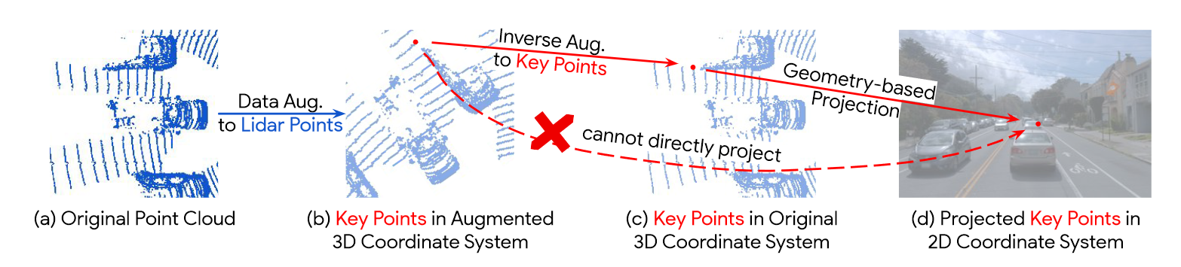
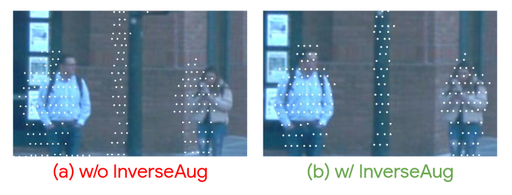
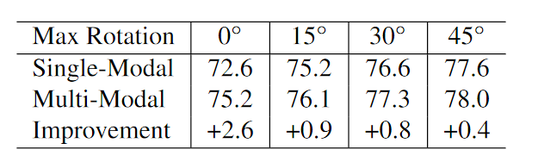
DeepFusion - Augmentation
Fig2 : Augmentation pipeline
Fig1 : Improvement with data augmentation
Fig3 : Comparative performance

Slide 39
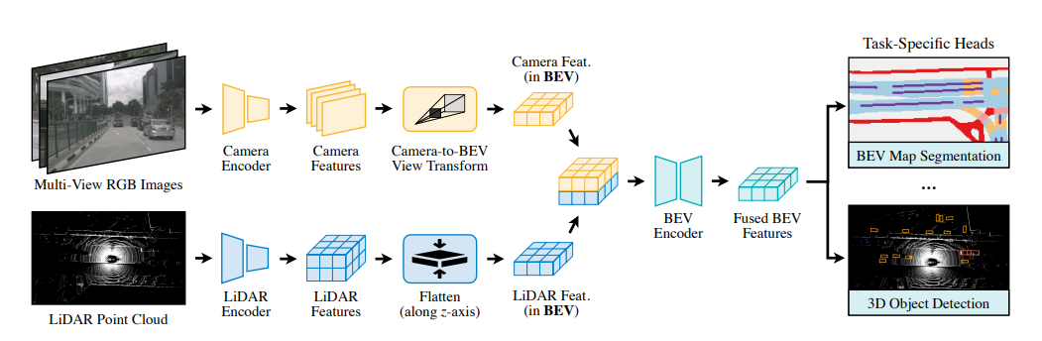
BEVFusion
Fig: Model Architecture

Slide 40
LoadPointsFromFileCoop
LoadPointsFromMultiSweepsCoop
LoadMultiViewImageFromFilesCoop
LoadAnnotations3D
VehiclePointsToInfraCoords
TransformLidar2ImgToInfraCoords
UnifiedObjectSampleCoop*
GlobalRotScaleTransAllCoop*
ResizeCropFlipImageCoop*
PointsRangeFilterCoop
ObjectRangeFilter
ObjectNameFilter
PointShuffleCoop*
NormalizeMultiviewImageCoop
PadMultiViewImageCoop
DefaultFormatBundle3DCoop
Collect3DCoop

Slide 41
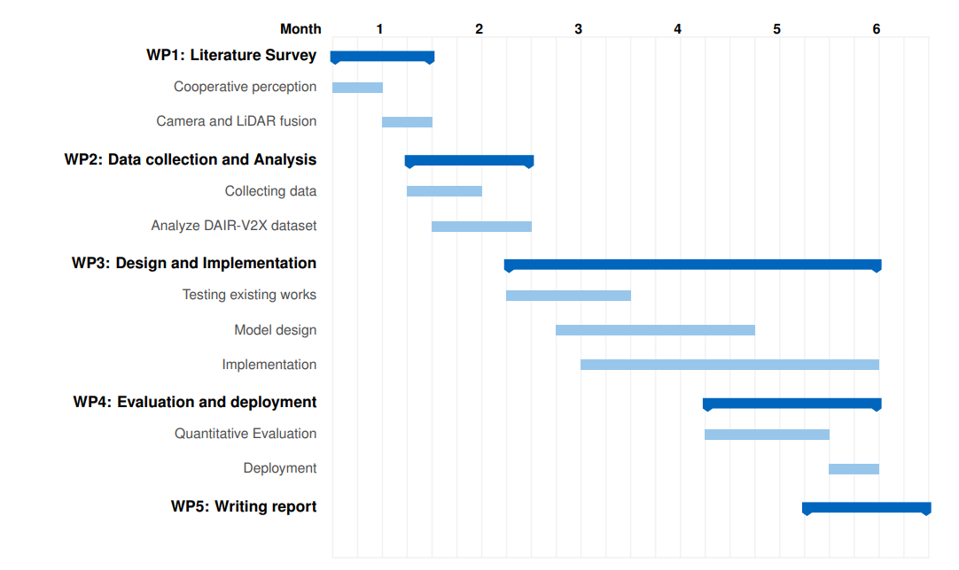
Work plan
Notes:
Finally, the IDP will be carried out for roughly six months in 5 stages.
Right now I’m in the literature survey stage. After this, an analysis will be done on the dataset.
Following this will be the implementation and evaluation, and the project ends with the documentation.

